Slide 1

Leukemia Cancer Detection using Machine Learning

Slide 2

Under the Guidance of : M. Srinivas
PBSN Sriya 21R11A0595
G Anshuman 21R11A0568
Dinesh 22R15A0510

Slide 3

CONTENTS
ABSTRACT
INTRODUCTION
EXISTING &PROPOSED SYSTEMS
SYSTEM CONFIGURATION
SYSTEM ARCHITECTURE& UML DIAGRAMS
METHODOLOGY
ALGORITHM USED
FINAL IMPLEMENTATION
CONCLUSION

Slide 4
ABSTRACT

Slide 5
ABSTRACT
Acute lymphoblastic leukemia (ALL) is a rare but serious form of blood cancer caused by the overproduction of abnormal lymphocytes in the bone marrow. Early and accurate detection is crucial for effective treatment and improved survival rates, especially in adults. Current diagnostic methods rely on manual microscopic analysis of blood smear images, which is time-consuming, subjective, and prone to errors, particularly when distinguishing between normal and malignant cells with similar morphologies. This project proposes an intelligent deep learning approach to automate the screening of white blood cells for the presence of leukemia using microscopic blood smear images. Convolutional neural networks (CNNs), including architectures such as Res Net and VGG, are employed to classify images of blood cells as either normal or leukemic. The goal is to improve early and accurate diagnosis of ALL, especially in adults, where prognosis is often poor if diagnosed late.

Slide 6
INTRODUCTION

Slide 7
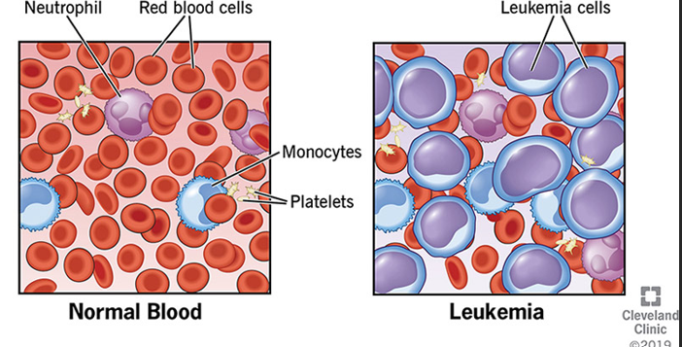
INTRODUCTION
Leukemia, a devastating form of cancer affecting individuals of all ages, which impact on white blood cells and the bone marrow. This study focuses on the development of an intelligent deep learning algorithm that utilizes microscopic blood smear images to differentiate between normal and leukemic cells .this project introduces an advanced approach using artificial intelligence (AI) and deep learning. Early detection through intelligent screening methods holds the key to enhancing treatment outcomes and reducing mortality associated with leukemia.

Slide 8
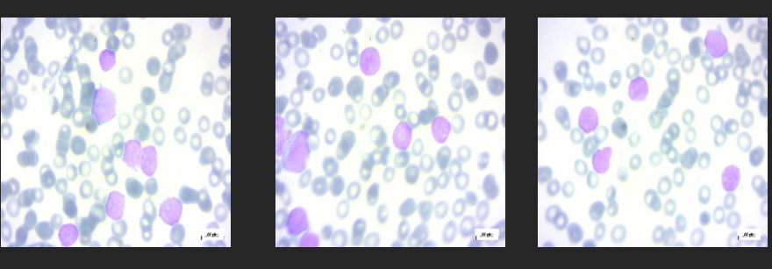
Leukemia is a cancer of the blood that affects white blood cells. There are several different types of leukemia, each classified by the type of white blood cell that is affected. Some common types of leukemia include:
Acute lymphocytic leukemia (ALL)
Acute myeloid leukemia (AML)
Chronic lymphocytic leukemia (CLL)
Chronic myeloid leukemia (cml)

Slide 9
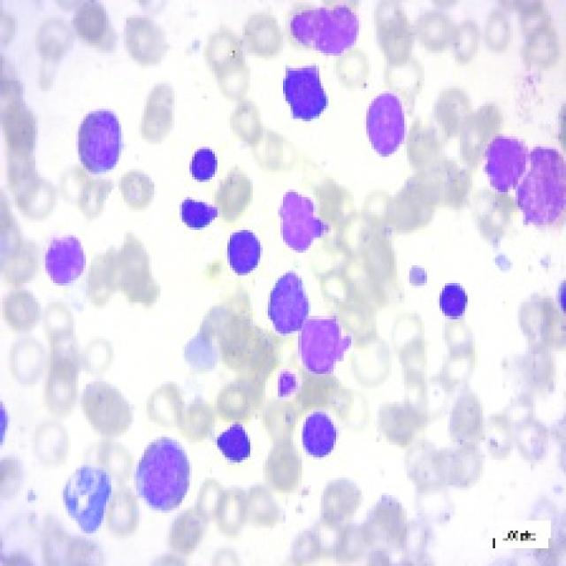
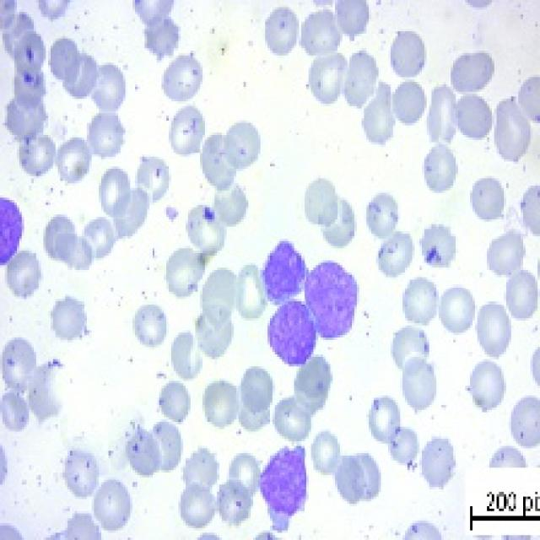
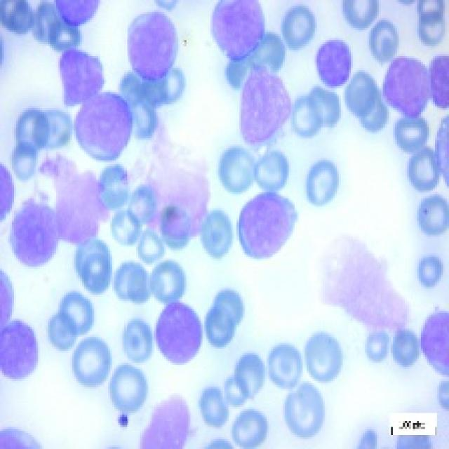
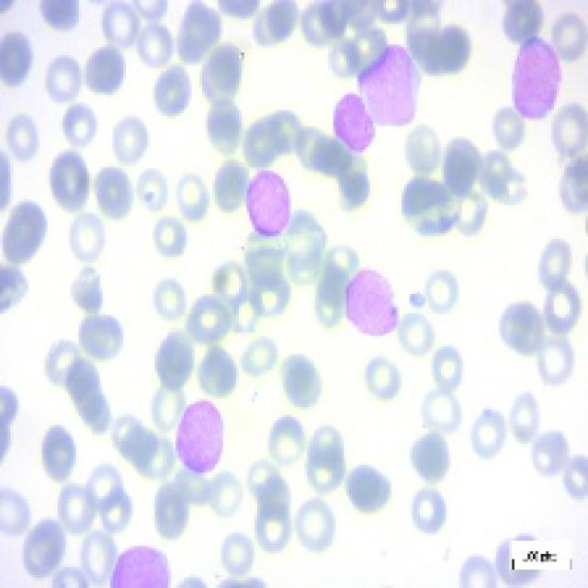
In leukemia ,cancer there are different stages include benign and malignant phases with the malignant stages further categorized as early , pre , pro
1.Bengin
2. Malignant early
3.Malignant pre
4.Malignant pro

Slide 10
EXISTING SYSTEM

Slide 11
Existing System:
Manual Diagnosis: Relies on pathologists examining blood smear images, which is labor-intensive.
Prone to Errors: Susceptible to human error and variability in results.
Time-Consuming: Slow and costly process with potential delays in diagnosis.

Slide 12
PROPOSED SYSTEM

Slide 13
Proposed System:
Automated Diagnosis: Utilizes deep learning models like CNN, ResNet, and VGG for faster, more accurate leukemia detection.
Scalable and Cost-Effective: Handles large volumes efficiently, reducing reliance on manual labor and lowering costs.
Consistent and Early Detection: Ensures consistent results with the potential for early diagnosis, improving patient outcomes.

Slide 14
SYSTEM CONFIGURATION

Slide 15
SYSTEM CONFIGURATION
SOFTWARE REQUIREMENTS:
Backend: Flask for handling requests and model communication.
Models: MobileNet50 for image validation; CNN for leukemia classification.
Frontend: Simple HTML/CSS for image uploads.
Storage: File-based in "static/uploads/".
Deployment: Python-capable server for real-time processing.
HARDWARE REQUIREMENTS:
RAM: 16 GB+ for smooth processing.
CPU: Intel i5/AMD Ryzen 5+ for efficient multitasking.

Slide 16
SYSTEM ARCHITECTURE

Slide 17
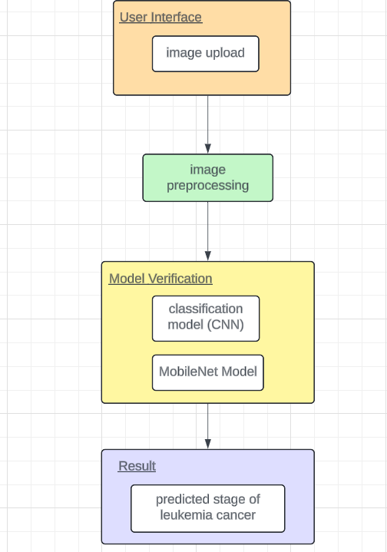
SYSTEM ARCHITECTURE

Slide 18
UML DIAGRAMS

Slide 19
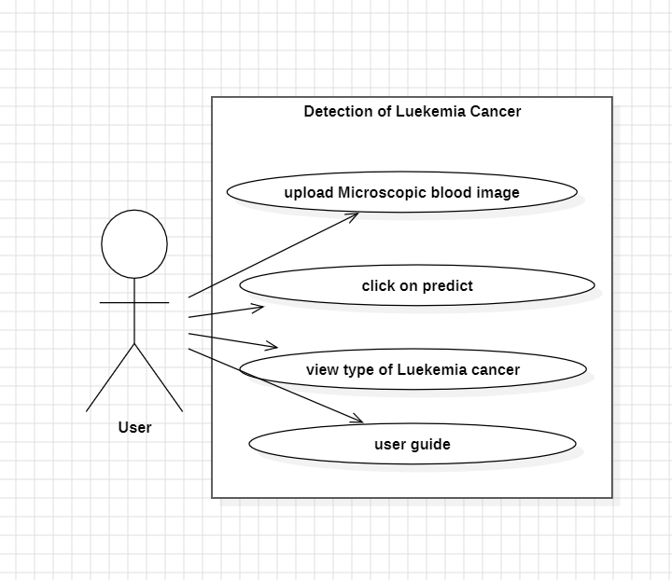
USECASE DIAGRAM

Slide 20
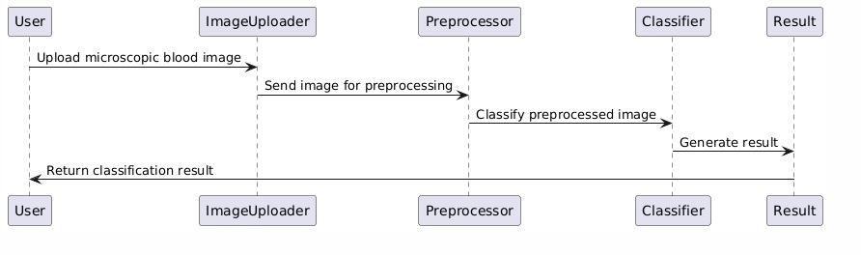
SEQUENCE DIAGRAM

Slide 21
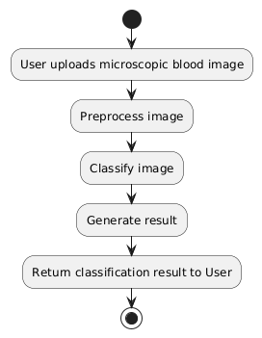
ACTIVITY DIAGRAM

Slide 22
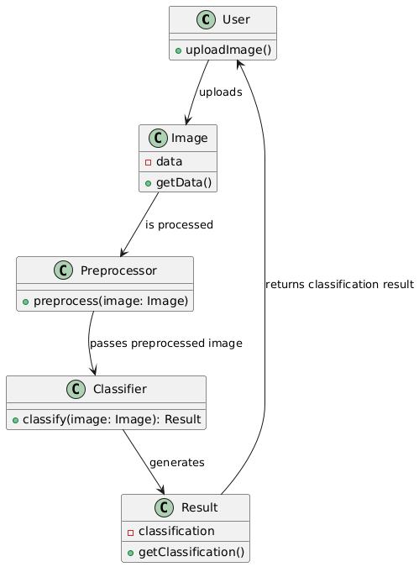
CLASS DIAGRAM

Slide 23
Methodology
Data source
Preprocessing the images
Exploratory Data Analysis
Import images

Slide 24
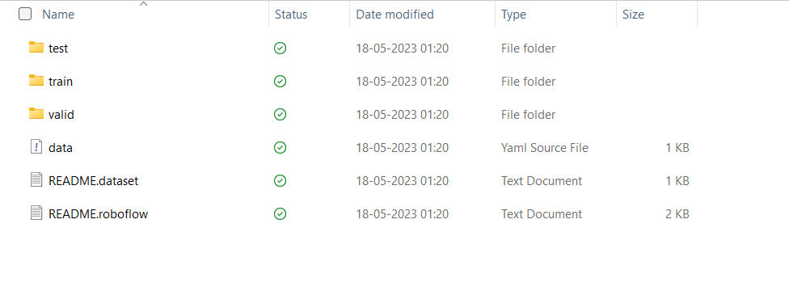
Data Source

Slide 25
Importing the image dataset into python:
Utilize libraries such as OpenCV or PIL to import the dataset into Python.
These libraries and modules are crucial for image processing and deep learning tasks in the project.
Contains 7535 images classified in a Multi-Class Classification style for detecting leukemia cancer.

Slide 26

Pre-processing the images using data Augmentation
The input images are in JPEG format and uses t.image.decode_jpeg to convert the raw data into tensors. The channels=3 parameter ensures these tensors represent RGB images with three color channels.
Apply data augmentation techniques such as rotation, flipping, scaling, and cropping to increase the diversity of the dataset.
All images are resized to a consistent size of [640,640] using tf.image.resize. This ensures compatibility with the deep learning model, as many models require images with uniform dimensions.
Normalization to the 0-1 range by dividing by 255.0.
Further normalization to the -1 to 1 range using multiplication by 2 and subtraction by 1.

Slide 27
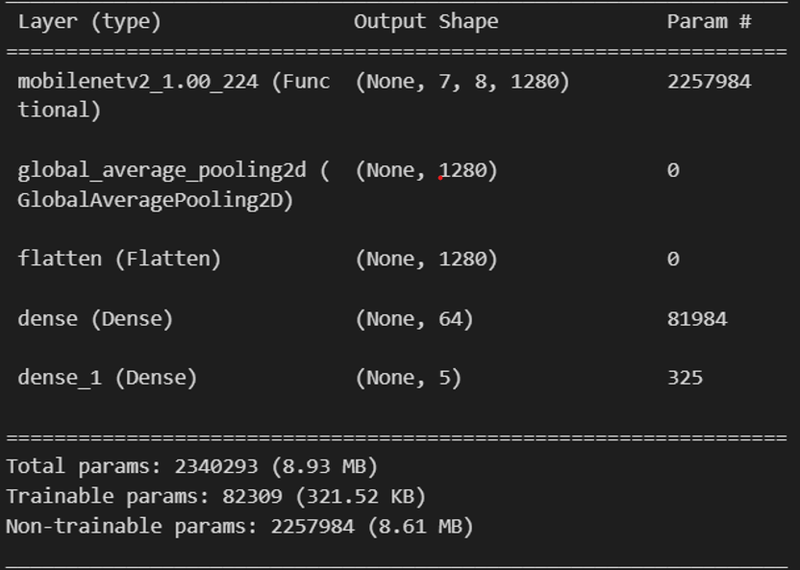
ALGORITHM
USING CNN Model and Mobile Net Model
The first layer is a MobileNetV2 layer with an output shape of (None, 7, 7, 12800) and approximately 2,257,984 parameters.
The first Dense layer has an output shape of (None, 64) and 81,984 parameters. The second Dense layer (Dense_1) has an output shape of (None, 5) and 325 parameters.

Slide 28
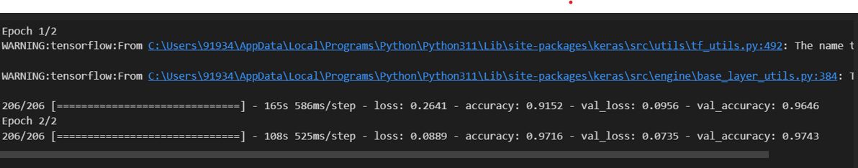
ACCURACY
Mobile Net V2 has achieved an accuracy of 0.9716, which translates to 97% accuracy.

Slide 29
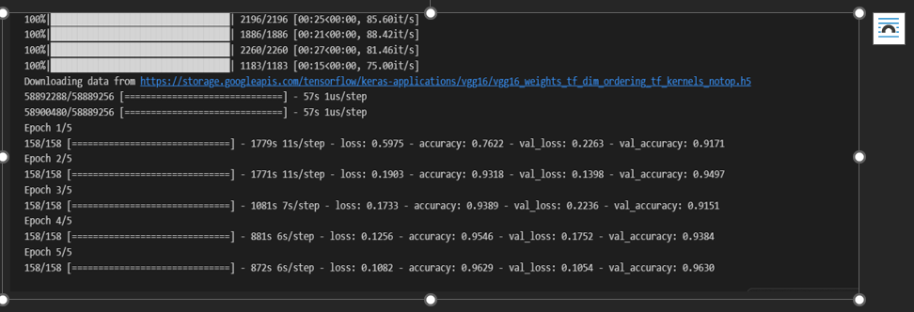
USING VGG16 model

Slide 30
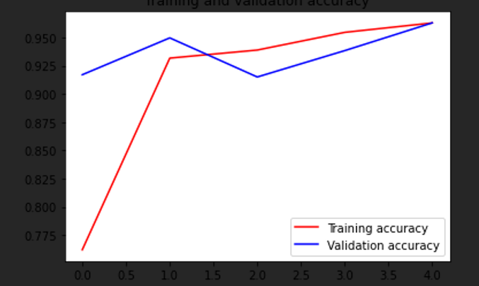
load images from different directories (categories), resize them to a fixed size (224x224), and store them along with their corresponding labels in lists X and y.
·Convert the lists of images and labels into NumPy arrays.
·Split the data into training and testing sets using train_test_split from scikit-learn.
·Normalize the pixel values of images to the range [0, 1].
·Convert categorical labels into one-hot encoded vectors using to_categorical from TensorFlow.
·Load the VGG16 model pretrained on the ImageNet dataset, excluding the top classification layer.
The model is being trained for 5 epochs.

Slide 31
Comparing the Algorithms
Comparing the both models using CNN model and Mobile Net model has the highest accuracy of 97% and while VGG16Model has 96% so final implementation has done in the CNN Model and Mobile Net model and trained using CNN Model in keras and app.py file is created

Slide 32

FINAL IMPLEMENTATION
Click on flask run to run the API as app.py in the terminal the display would be generate link
Click on the web page link of http://127.0.0.1:5000 then web page is live now it predicts the stage of the leukemia cancer
By uploading the image of leukemia cancer

Slide 33
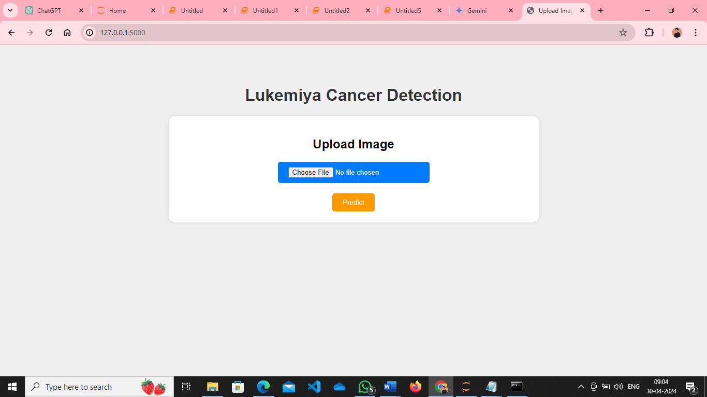
The website is :

Slide 34
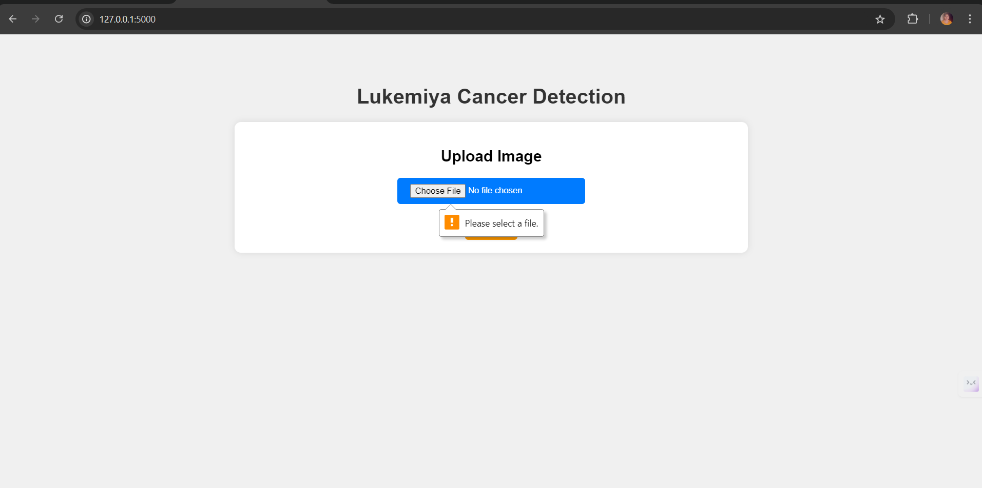

Slide 35
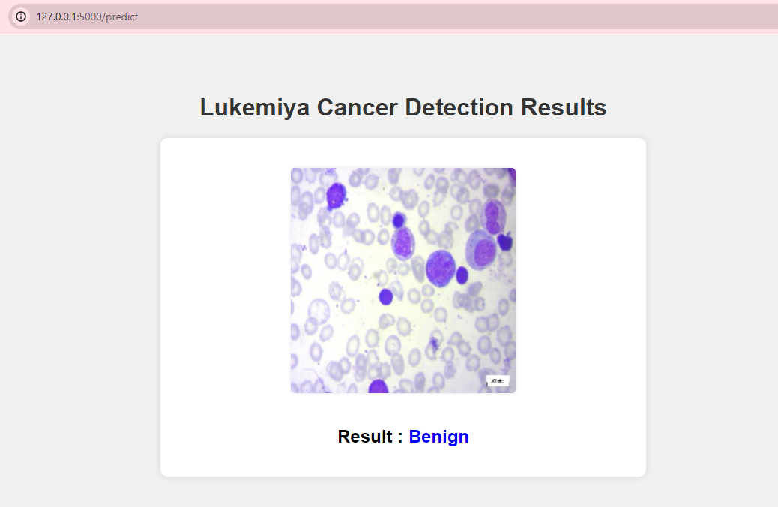

Slide 36
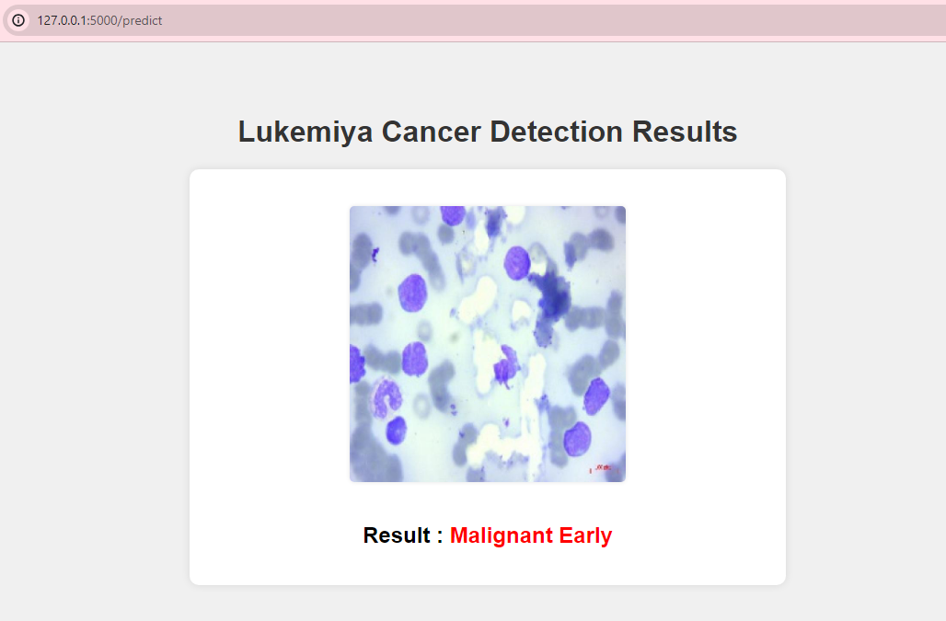

Slide 37
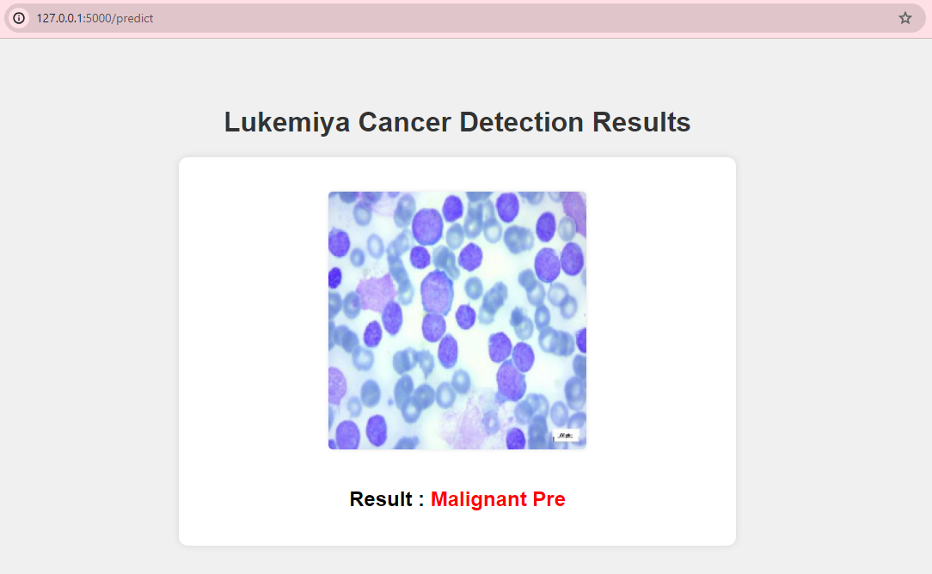

Slide 38
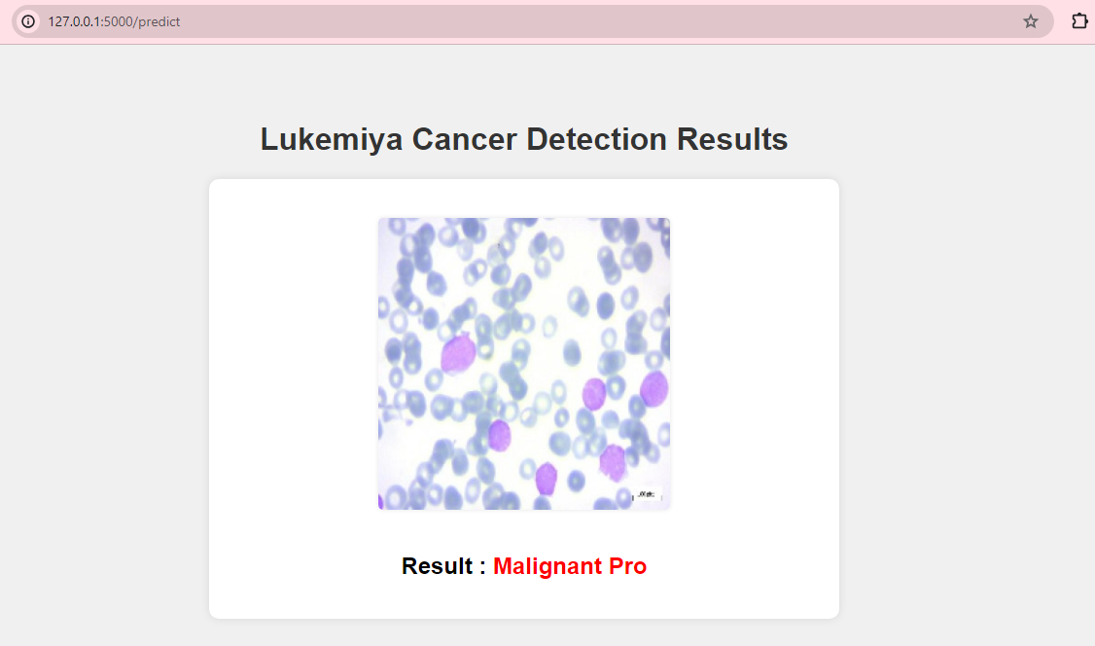

Slide 39
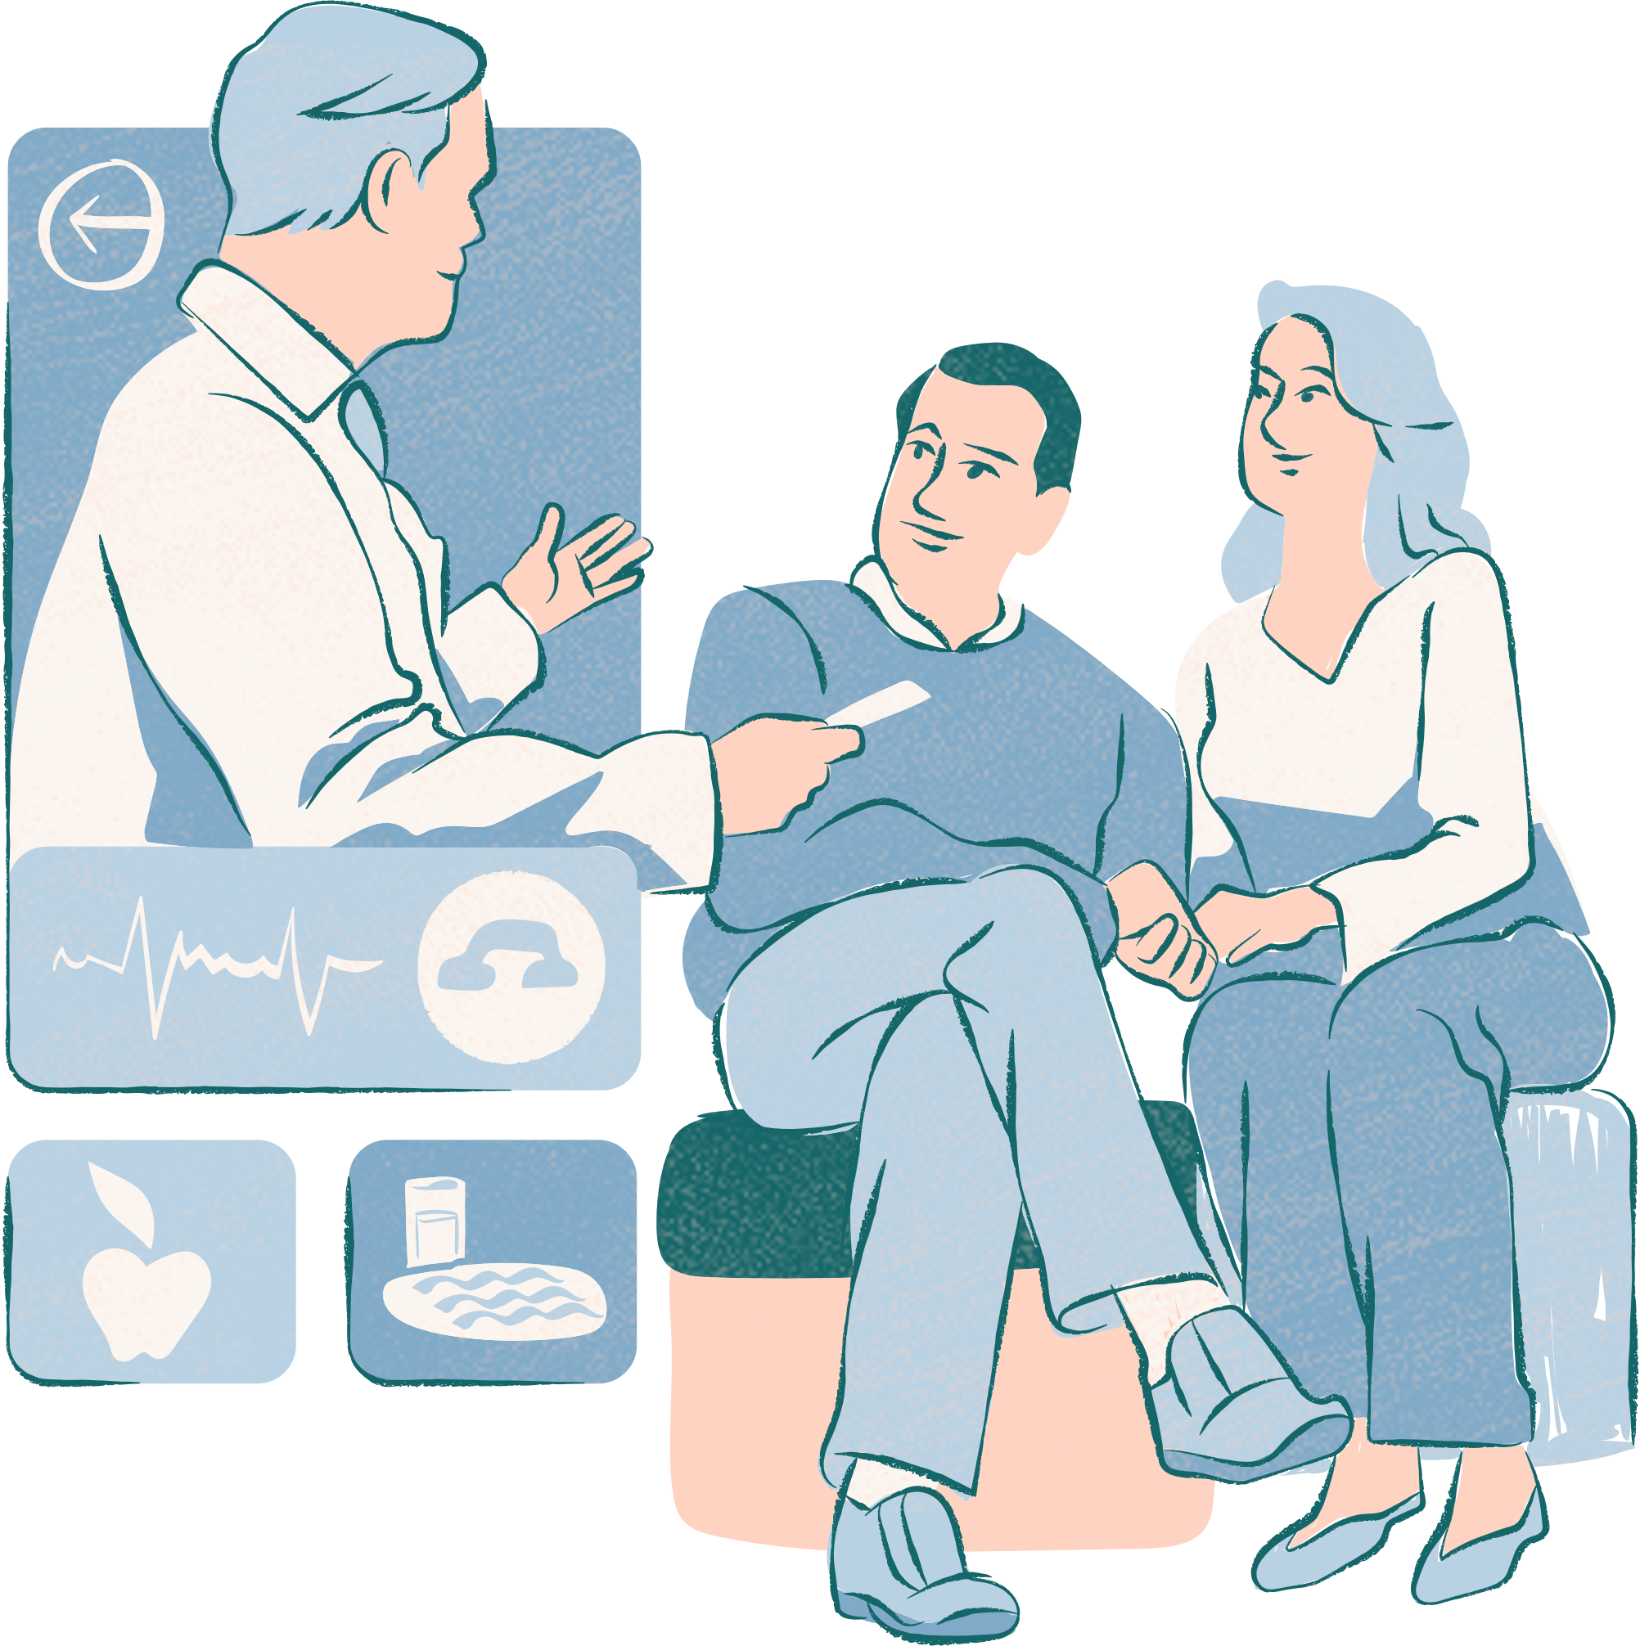
Conclusion
In this project, we developed an intelligent deep learning algorithm for the detection of leukemia cancer using image classification techniques. The algorithm utilizes Convolutional Neural Networks (CNNs), specifically the MobileNetV2 architecture, to analyze microscopic blood smear images and differentiate between normal and leukemic cells. Through extensive preprocessing, data augmentation, and model training, we achieved a high accuracy rate of 97% on the test dataset. Our algorithm has the potential to significantly impact the field of medical diagnostics by providing a faster, more accurate, and scalable solution for leukemia detection. Future work could involve expanding the dataset to include more diverse samples, optimizing the model further, and integrating it into clinical settings for real-time diagnosis and treatment planning.

Slide 40
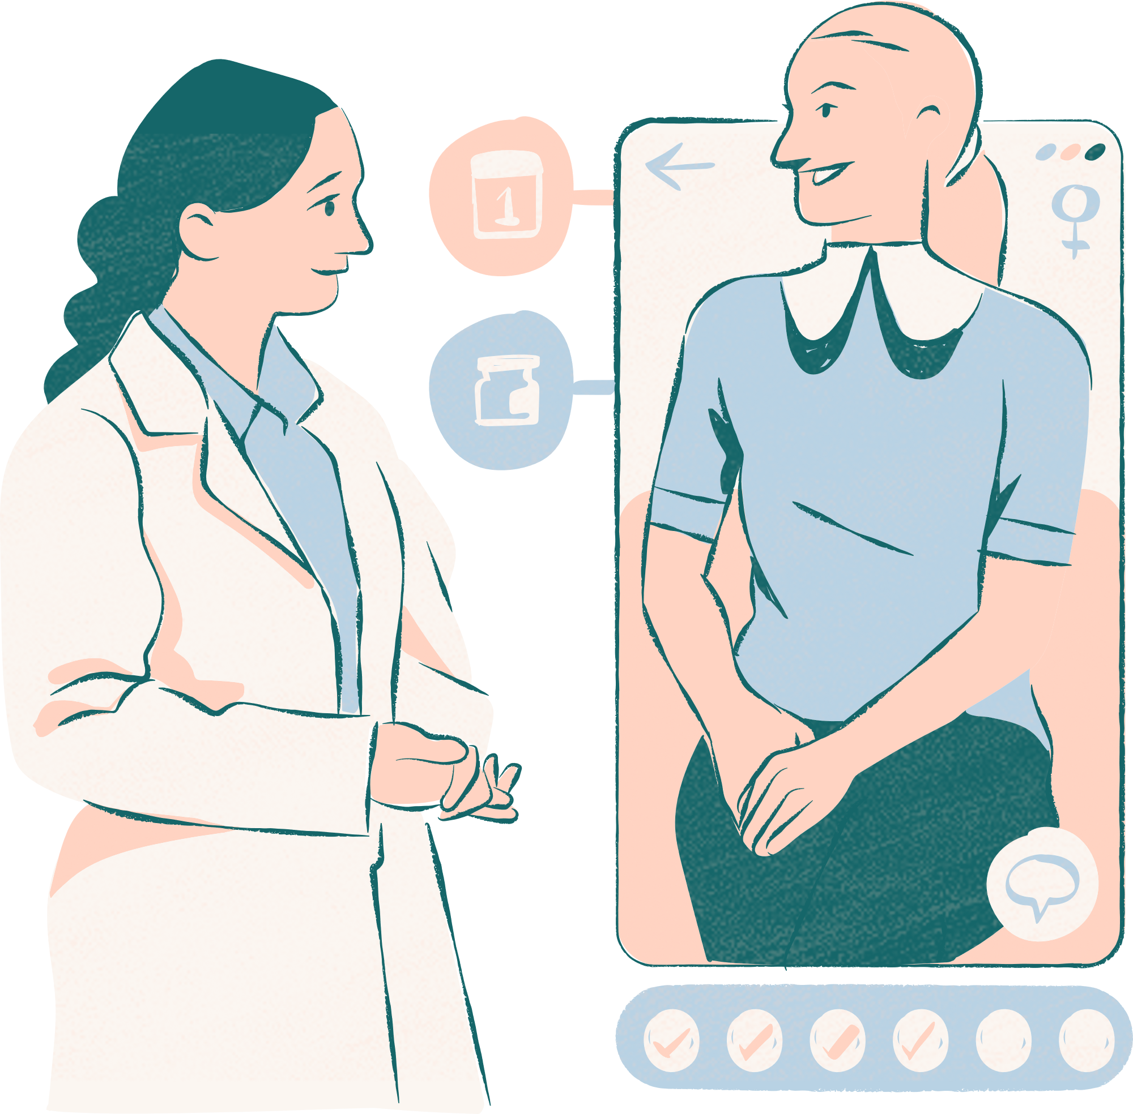
Thank you

